Slide 1
Looking at Visual Attention in Value-Based Decision Making
Brenden Eum
SDN Proseminar

Slide 2
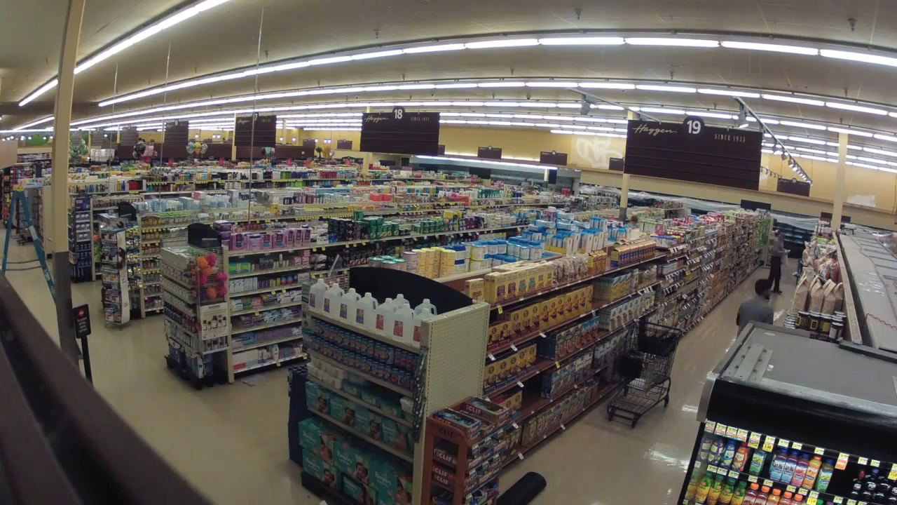

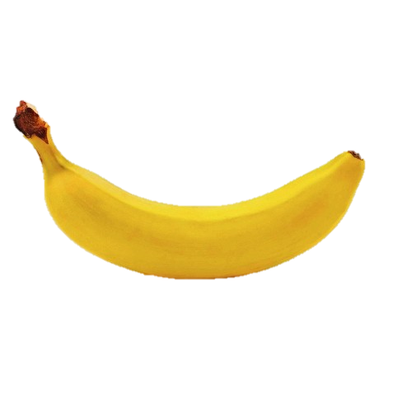
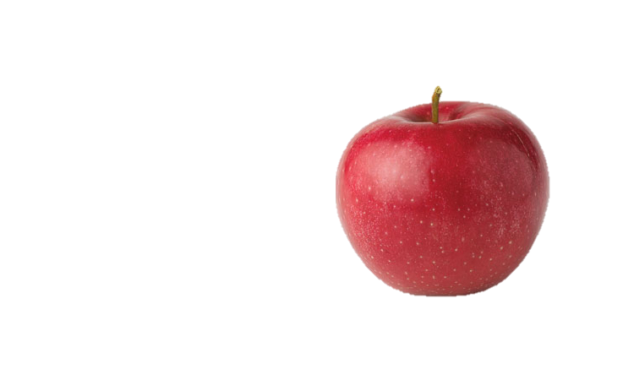

Slide 3
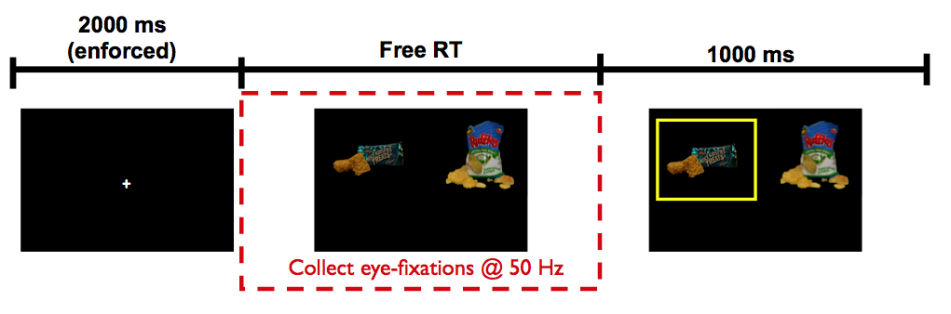
Krajbich, Armel, Rangel (2010, Nat Neuro)

Slide 4
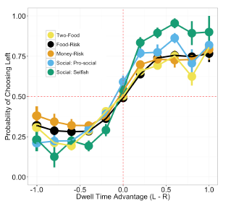
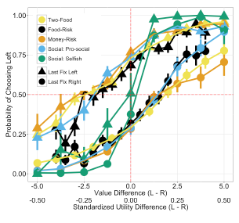
Net Fixation Bias
Last Fixation Bias
Smith, Krajbich (2018, J Exp Psychol Gen)
Notes:
multiple domains

Slide 5
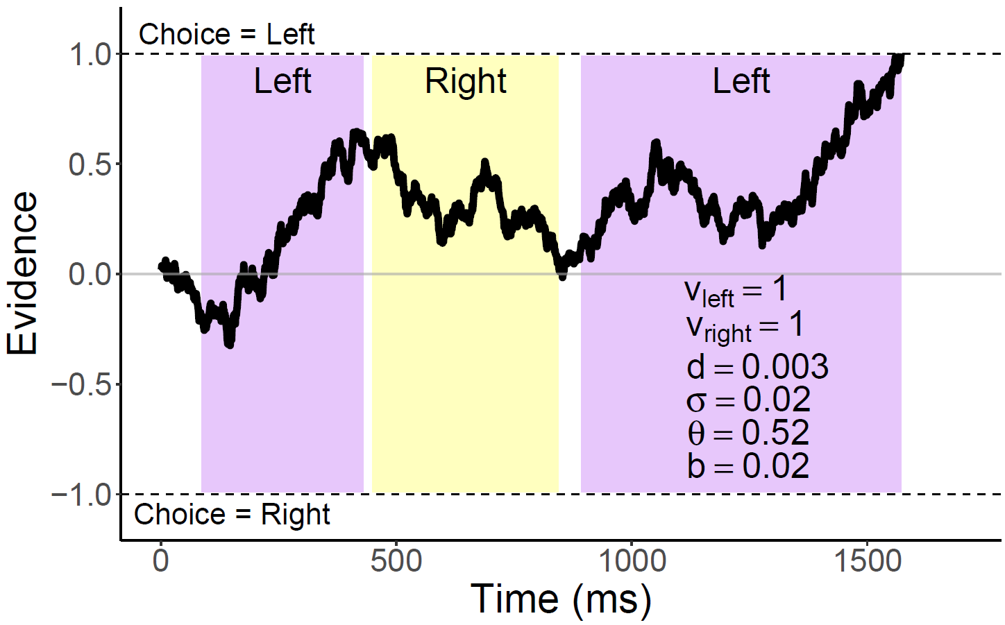
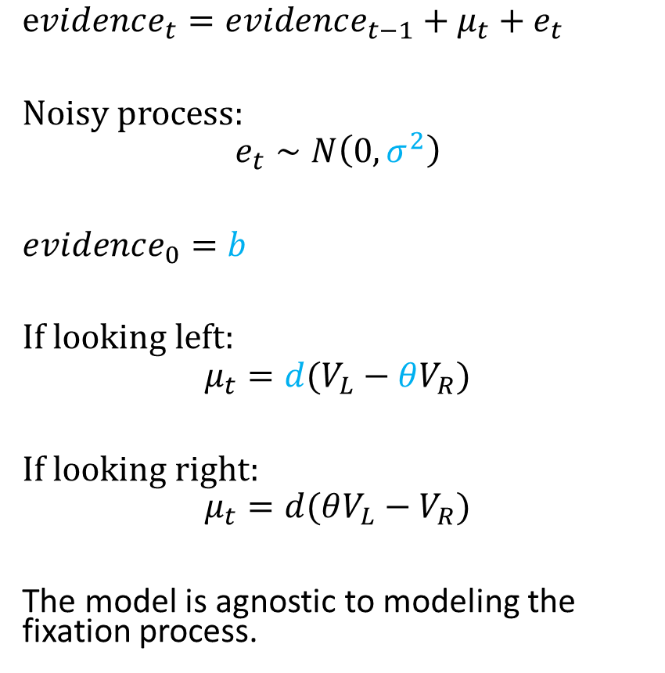
Attentional Drift-Diffusion-Model (aDDM)
$evidence_{t}=evidence_{t−1}+μ_{t}+e_{t}$
Noisy process:
$$e_{t}∼N\left(0, σ^{2}\right)$$
$evidence_{0}=b$
If looking left:
$$μ_{t}=d(V_{L}−θV_{R})$$
If looking right:
$$μ_{t}=d(θV_{L}−V_{R})$$
The model is agnostic to modeling the fixation process.
Notes:
noisy
bias
drift: ddm in value based decisions: evidence accumulated is value comparison
drift
sim
explain fixation sampling process

Slide 6
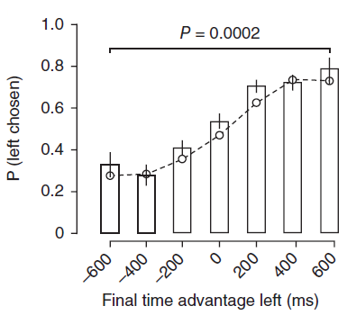
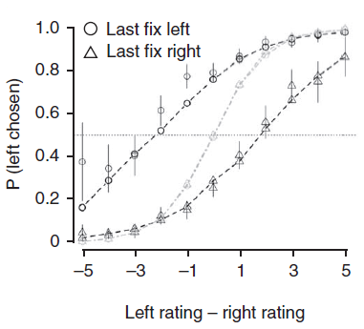
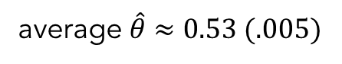
aDDM Predictions
average $\hat{θ}≈0.53 (.005)$
1. Attentional Discounting
2. Net Fixation Bias
3. Last Fixation Bias
Bhatnagar, Orquin (2022, J Exp Psychol Gen)
Krajbich, Armel, Rangel (2010, Nat Neuro)

Slide 7
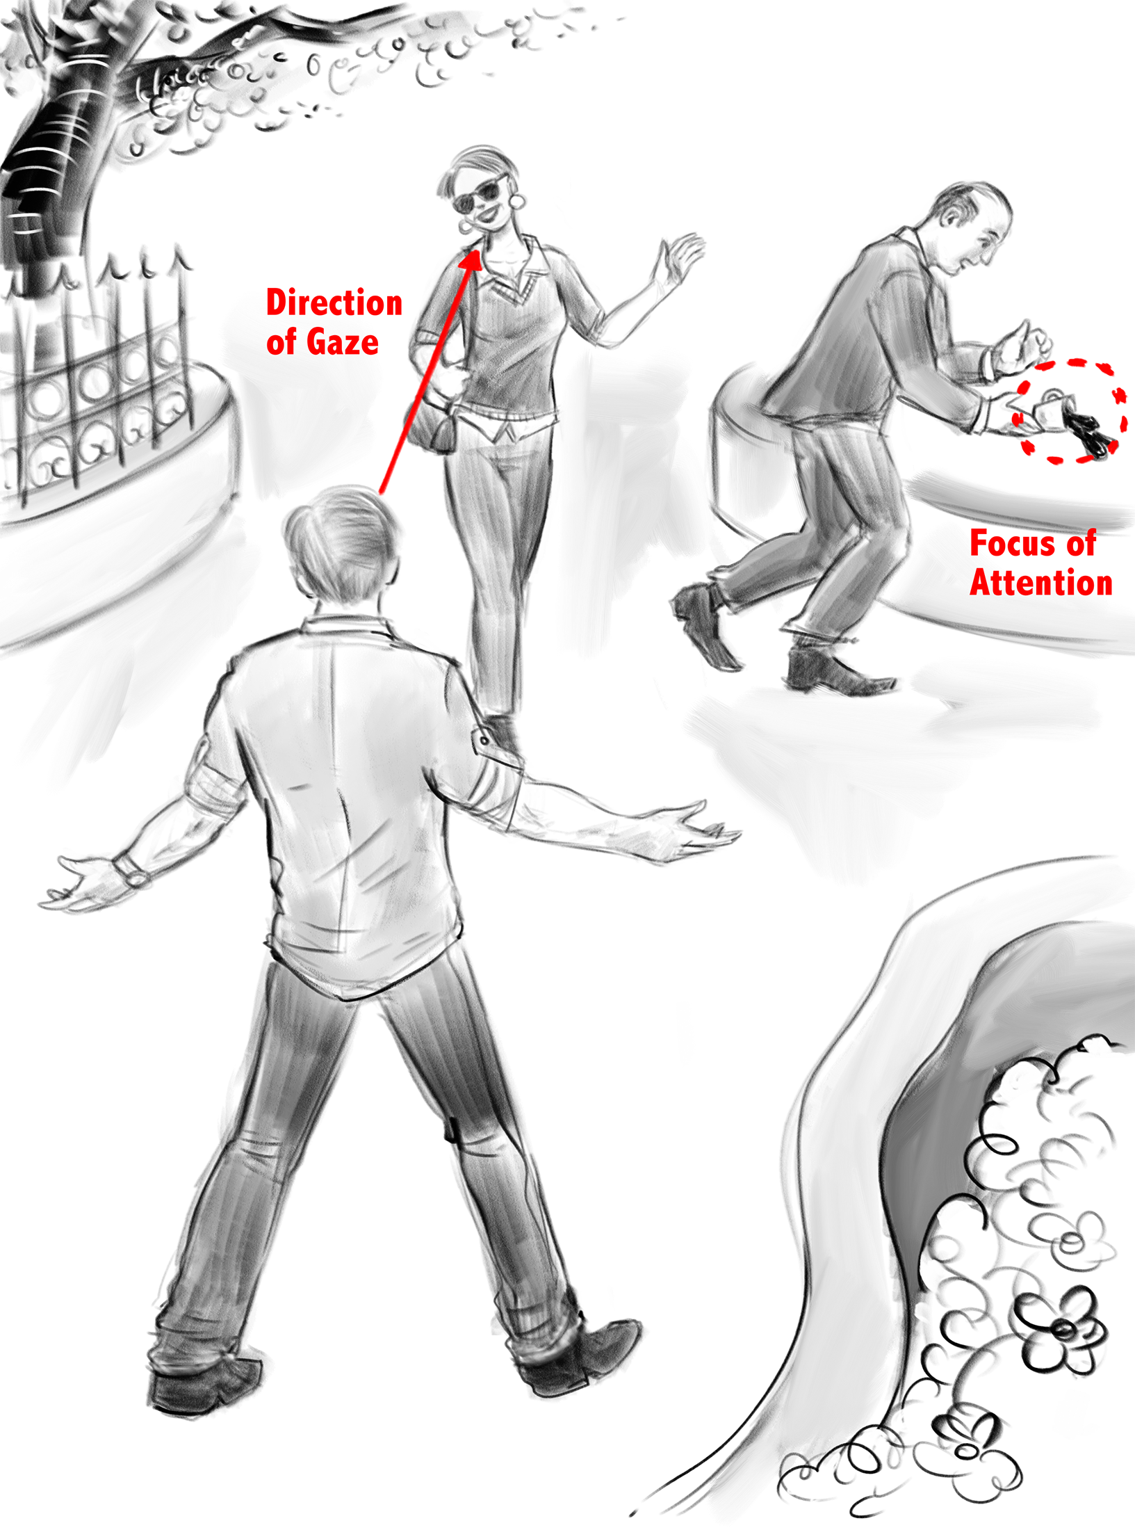
Overt vs Covert Attention
Drawing by Dr. Peter Coppin, OCAD
Notes:
overt
covert
bulk of literature overt

Slide 8



Slide 9



Slide 10
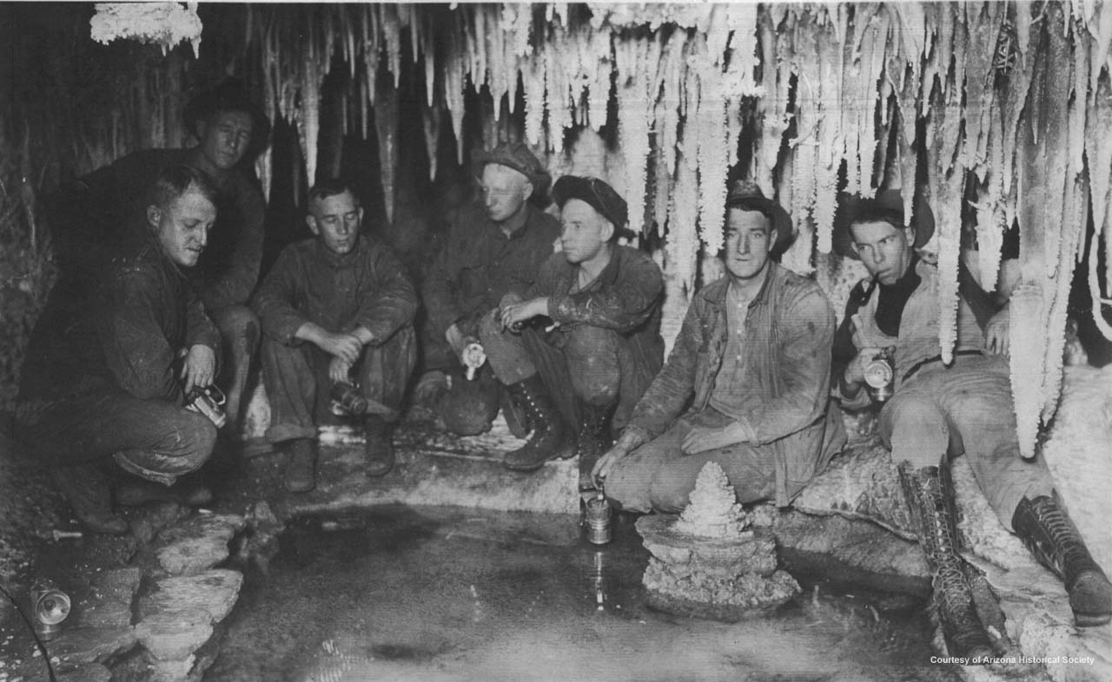
Copper Miners in Bisbee, Arizona
Notes:
Copper Miners in Bisbee, Arizona

Slide 11
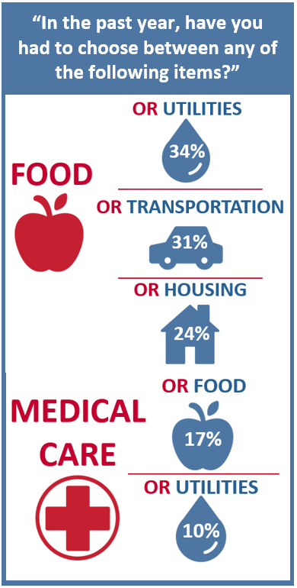
The Center for Community Solutions, Cleveland, Ohio

Slide 12
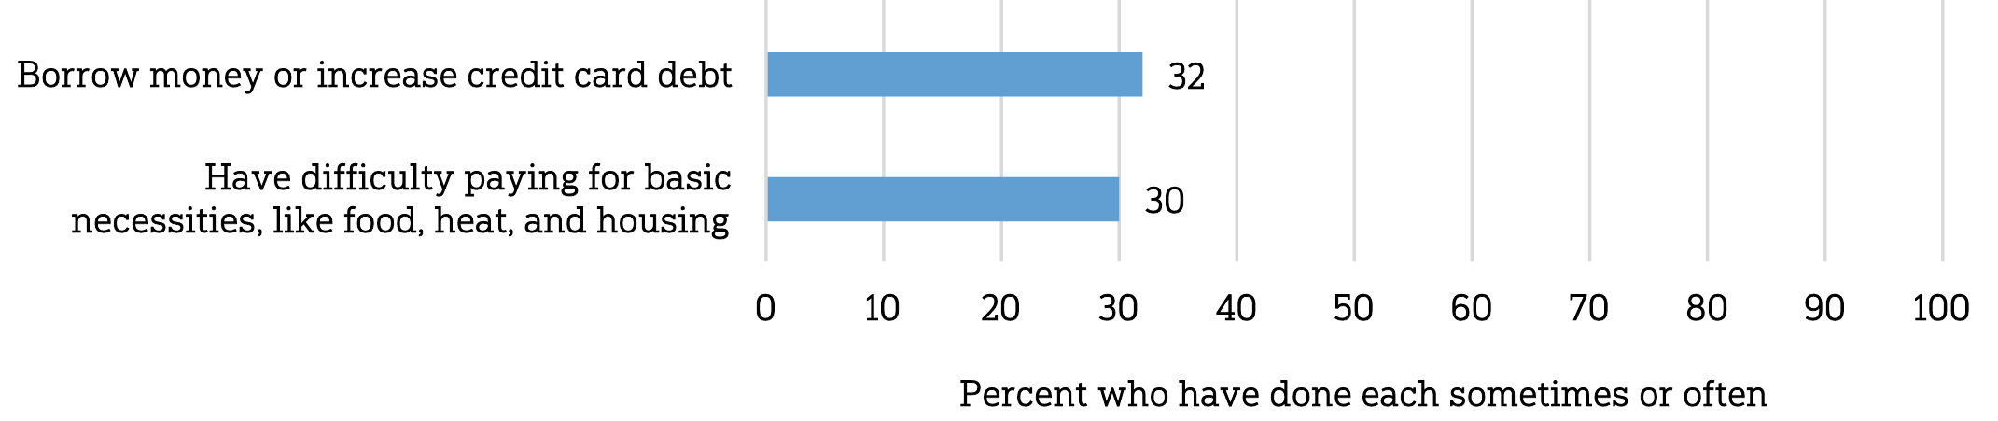
Does paying for healthcare costs cause you to…
The Center for Community Solutions, Cleveland, Ohio
NORC @ U Chicago / West Health Institute (2018)

Slide 14
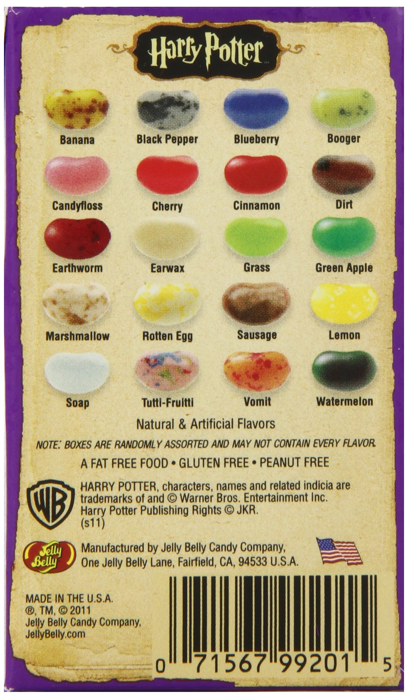

Slide 15
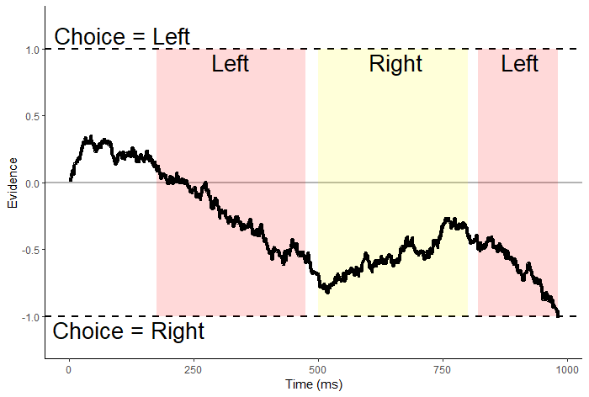
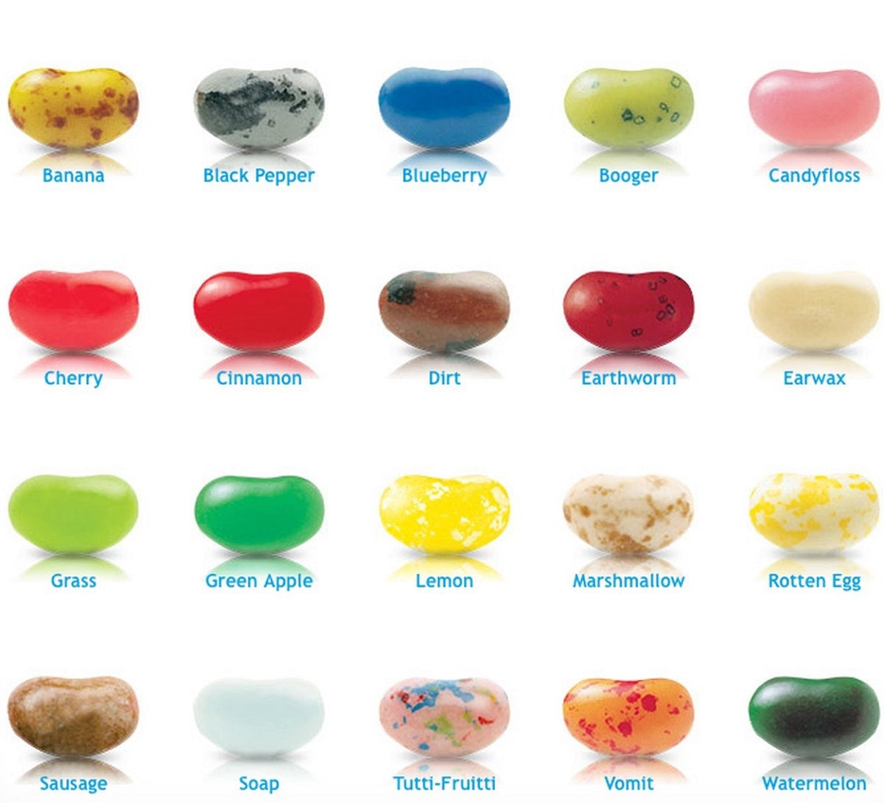
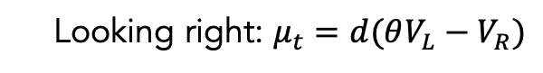

$evidence_{t}=evidence_{t−1}+μ_{t}+e_{t}$
Looking left: $μ_{t}=d(V_{L}−θV_{R})$
Looking right: $μ_{t}=d(θV_{L}−V_{R})$

Slide 16
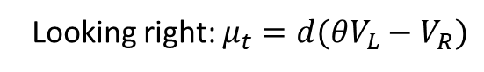
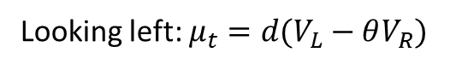
$evidence_{t}=evidence_{t−1}+μ_{t}+e_{t}$
Looking left: $μ_{t}=d(V_{L}−θV_{R})$
Looking right: $μ_{t}=d(θV_{L}−V_{R})$
If attentional discounting persists in choices between losses,
then the value of the nonfixated option should seem less negative
(i.e. better than it actually is).

Slide 17
Attentional choice biases
Net Fixation Bias
Last Fixation Bias
Pr(Left Chosen)
Pr(Choose Last Fix.)
Final Time Advantage Left
Left Rating - Right Rating

Slide 18
Attentional choice biases
should flip!
Net Fixation Bias
Last Fixation Bias
Pr(Left Chosen)
Pr(Choose Last Fix.)
Final Time Advantage Left
Left Rating - Right Rating

Slide 19
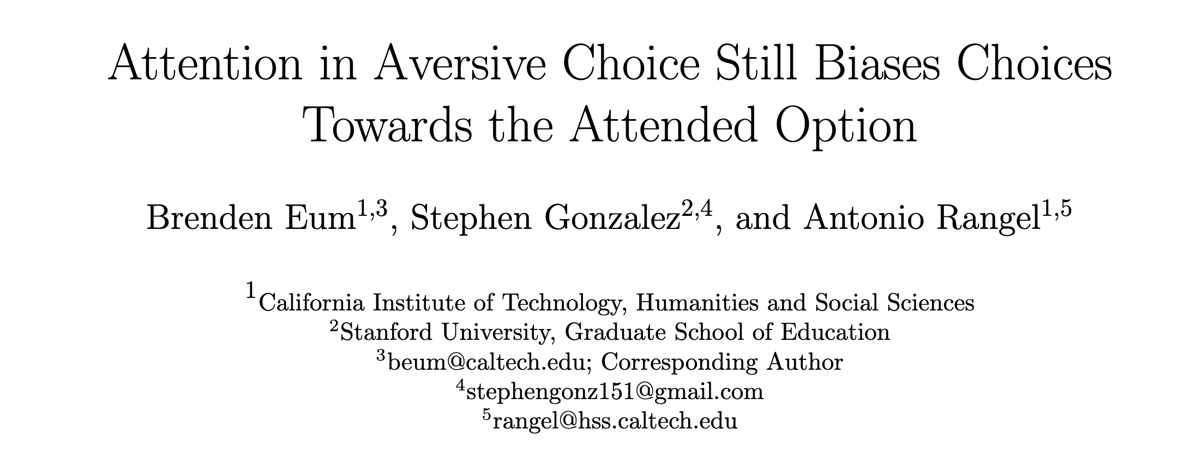
* title pending

Slide 20
Attention in Risky Gains
Attention in Losses

Slide 21
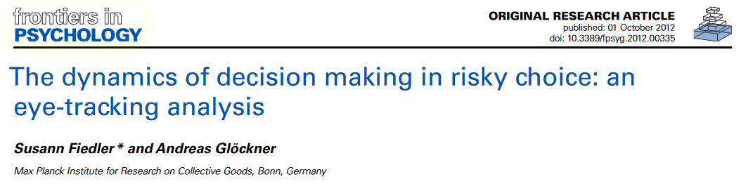
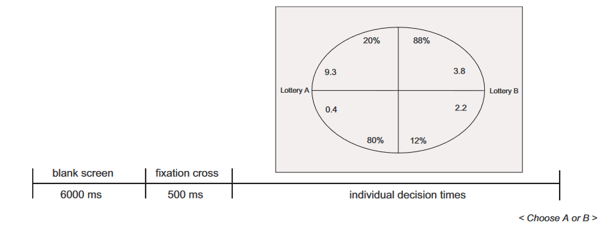
Attention in Risky Gains
Attention in Losses

Slide 22
Attention in Risky Gains
Attention in Losses

Slide 23
Attention in Risky Gains
Attention in Losses

Slide 24
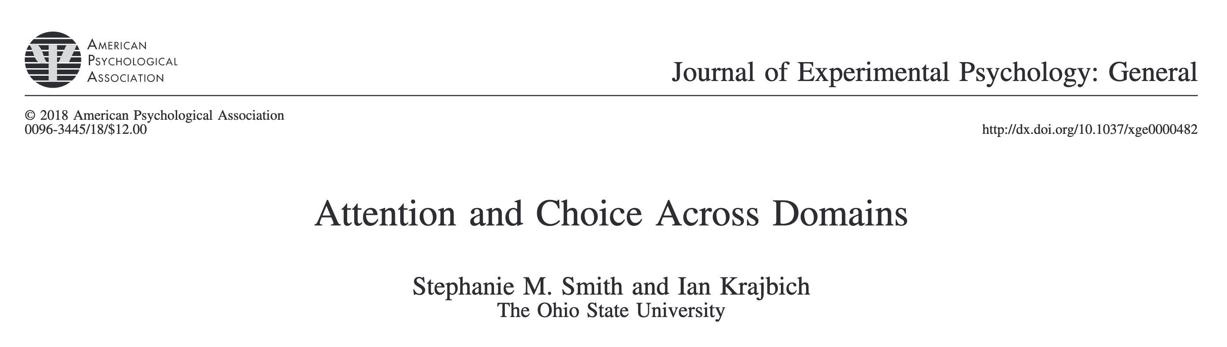
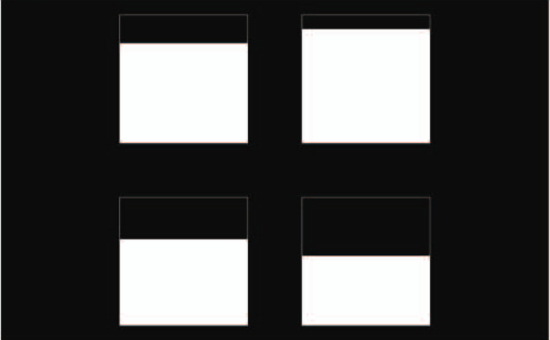
Attention in Risky Gains
Attention in Losses

Slide 25
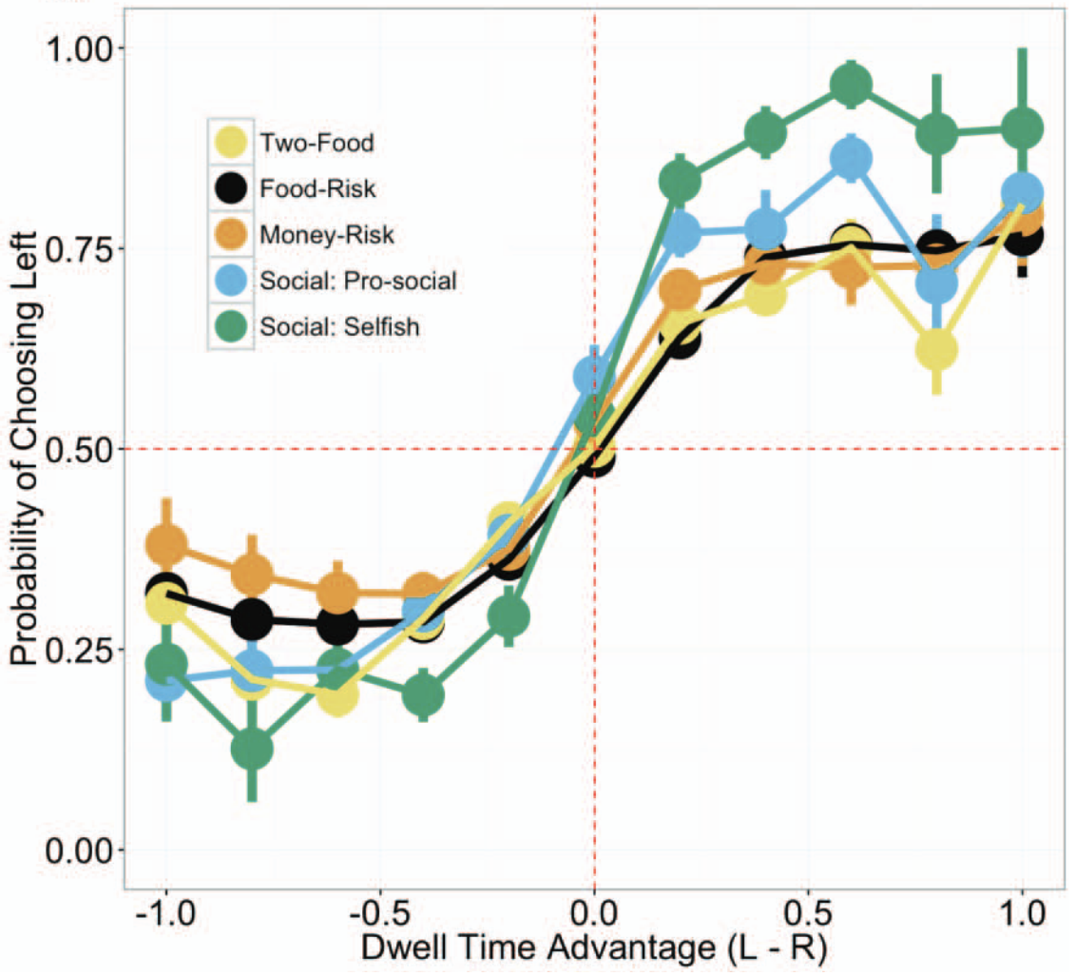
Attention in Risky Gains
Attention in Losses

Slide 26
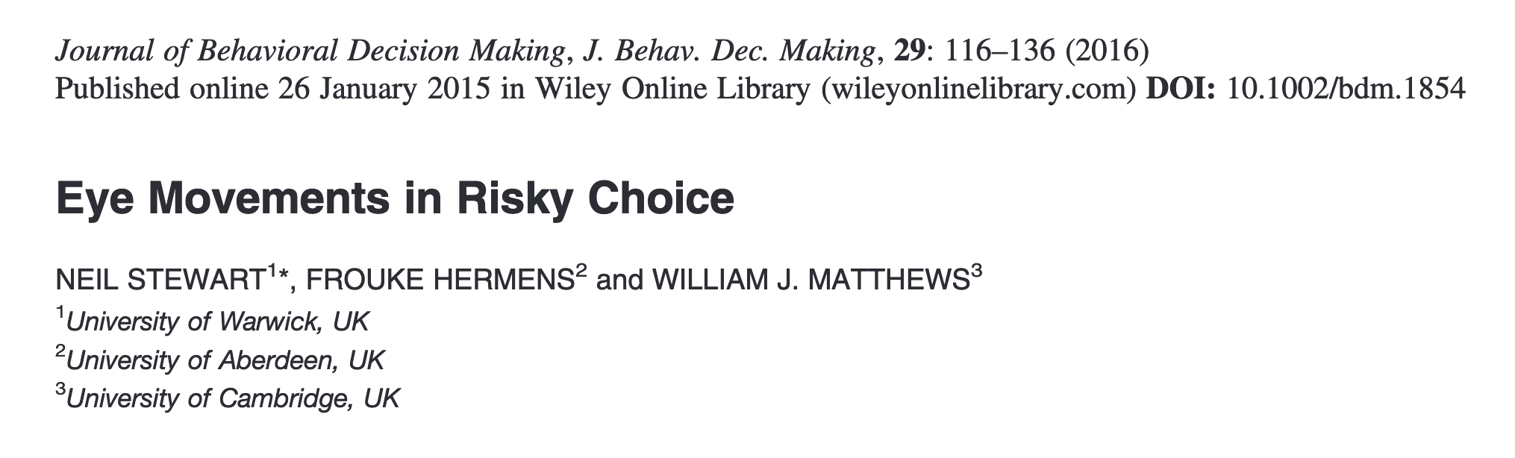
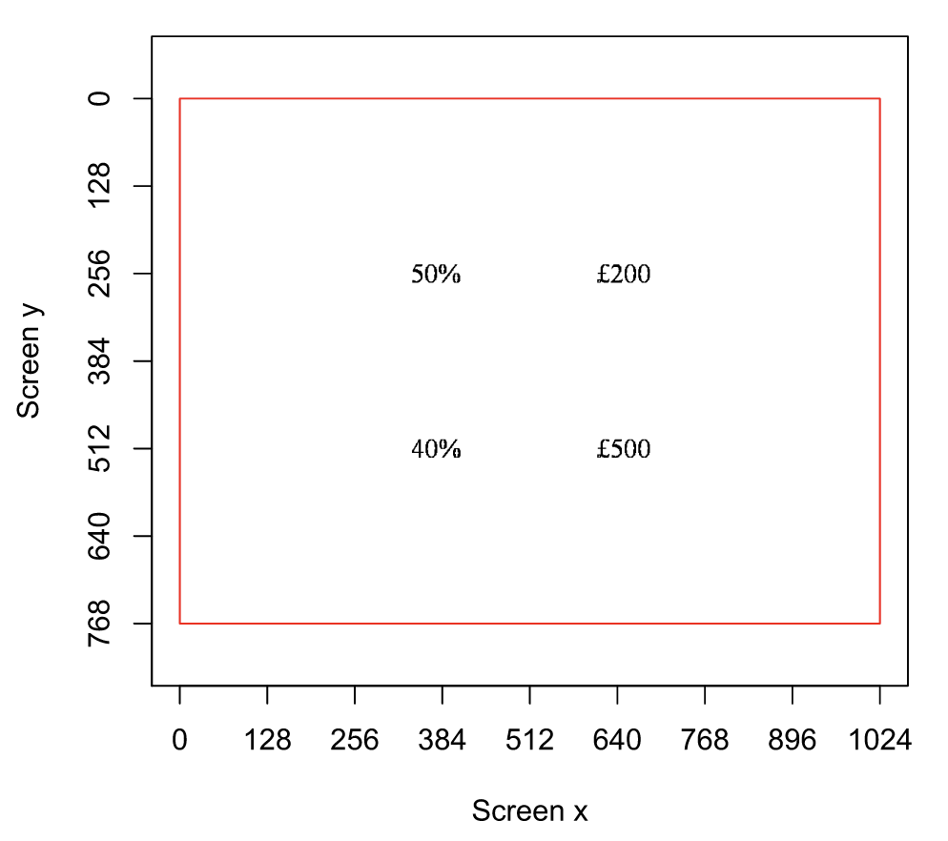
Attention in Risky Gains
Attention in Losses

Slide 27
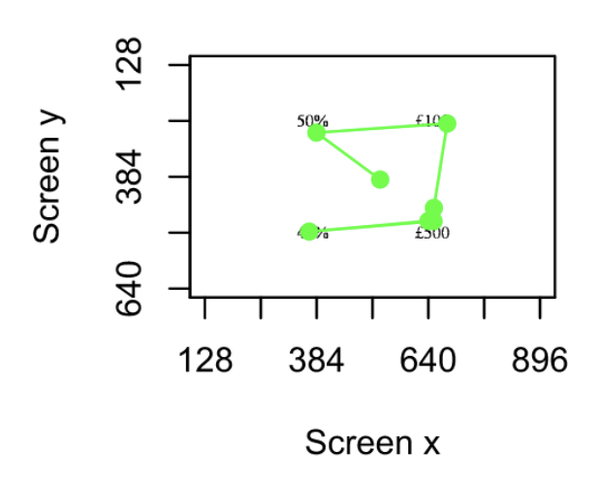
Attention in Risky Gains
Attention in Losses
Notes:
All attributes fixed roughly equally. Transition matrix stable across and within choices. Value independence from a logistic regression of choice on ___ variables and an interaction between #(fixations) and attribute value (4x: for each attribute). Either small or insignificant coefficients.

Slide 28
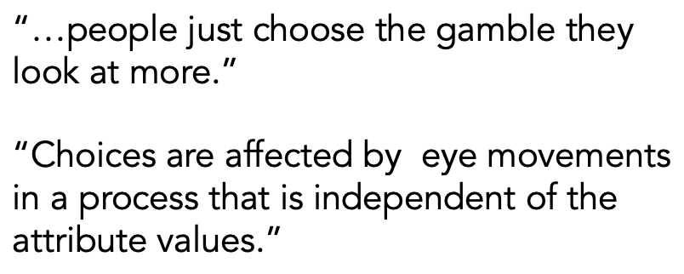
Attention in Risky Gains
Attention in Losses
Notes:
All attributes fixed roughly equally. Transition matrix stable across and within choices. Value independence from a logistic regression of choice on ___ variables and an interaction between #(fixations) and attribute value (4x: for each attribute). Either small or insignificant coefficients.

Slide 29
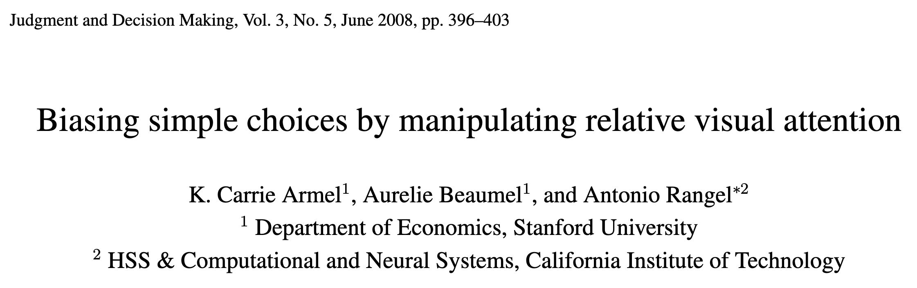
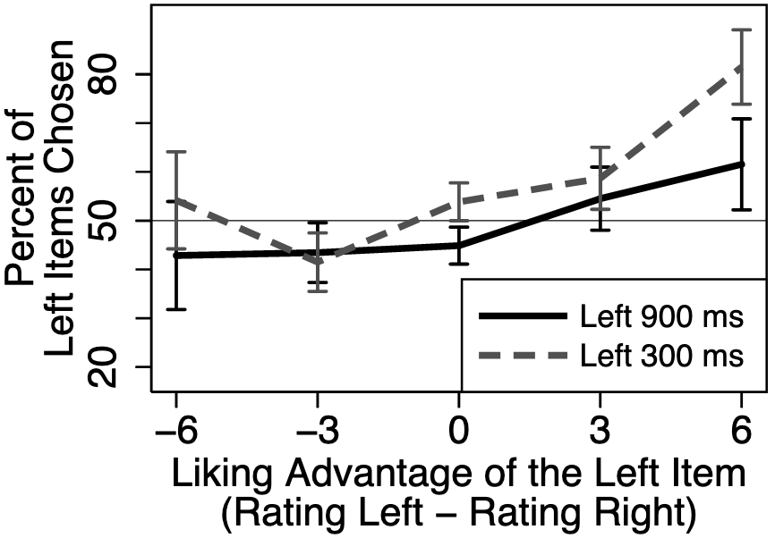
Attention in Risky Gains
Attention in Losses

Slide 30
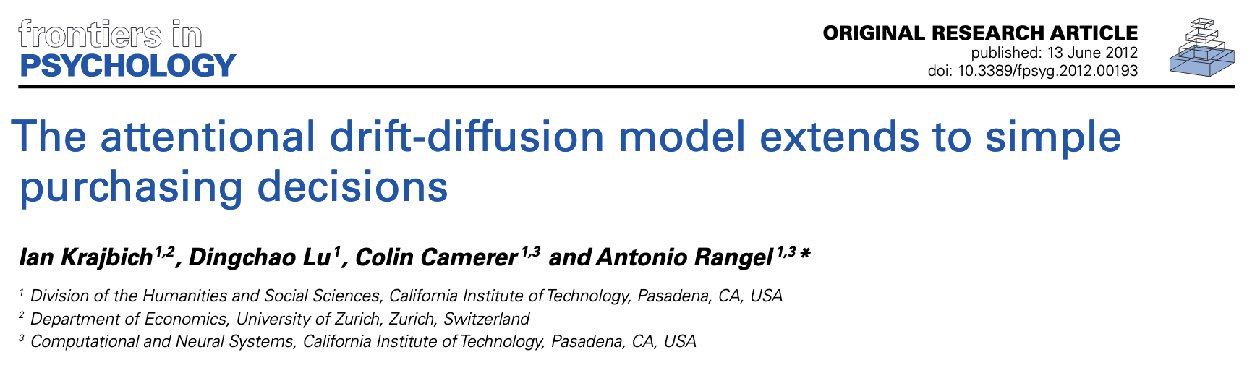
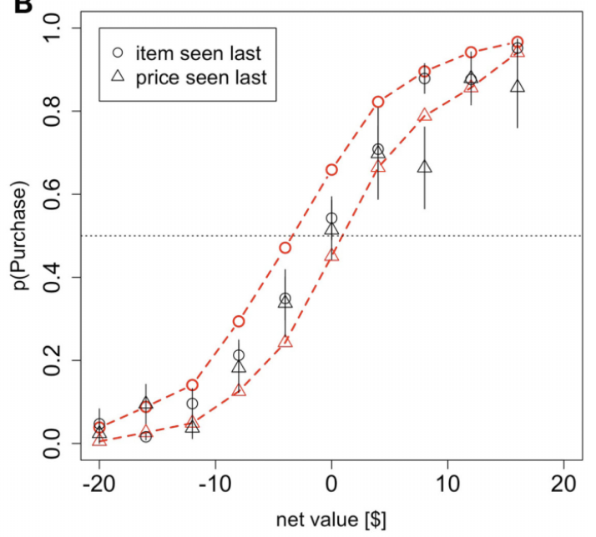
Attention in Risky Gains
Attention in Losses

Slide 31
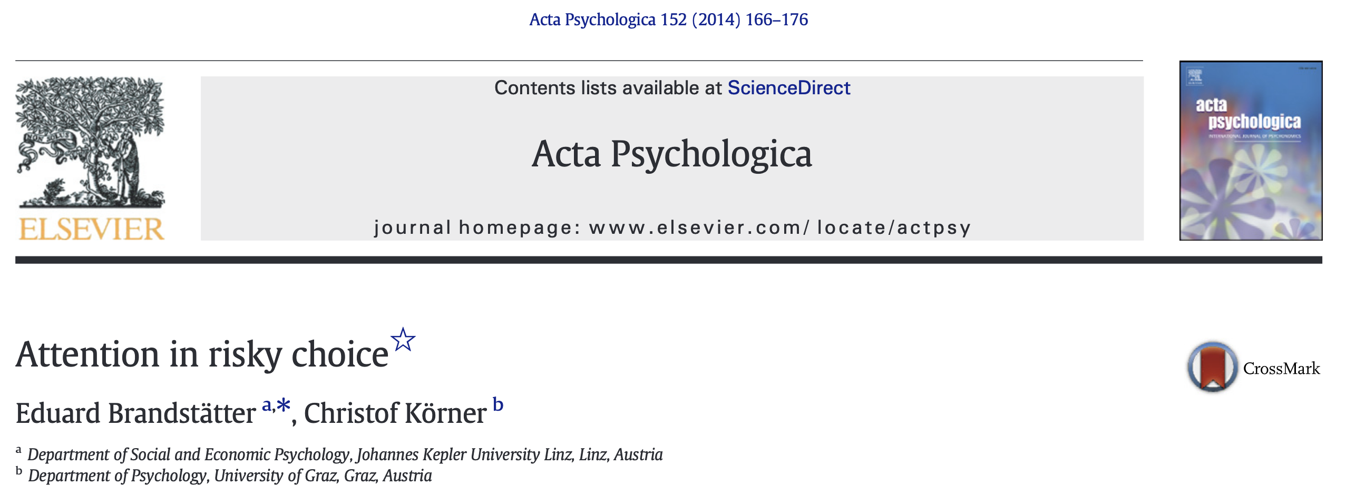
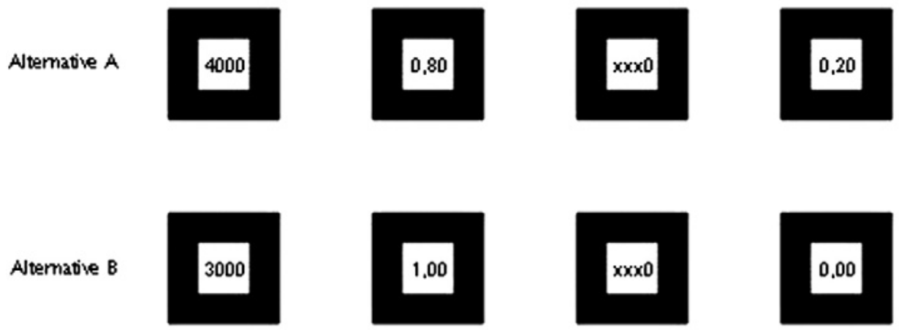
Attention in Risky Gains
Attention in Losses
Notes:
All attributes fixed roughly equally. Transition matrix stable across and within choices.

Slide 32
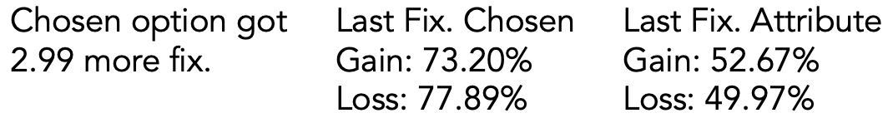
Attention in Risky Gains
Attention in Losses
Notes:
All attributes fixed roughly equally. Transition matrix stable across and within choices.

Slide 33
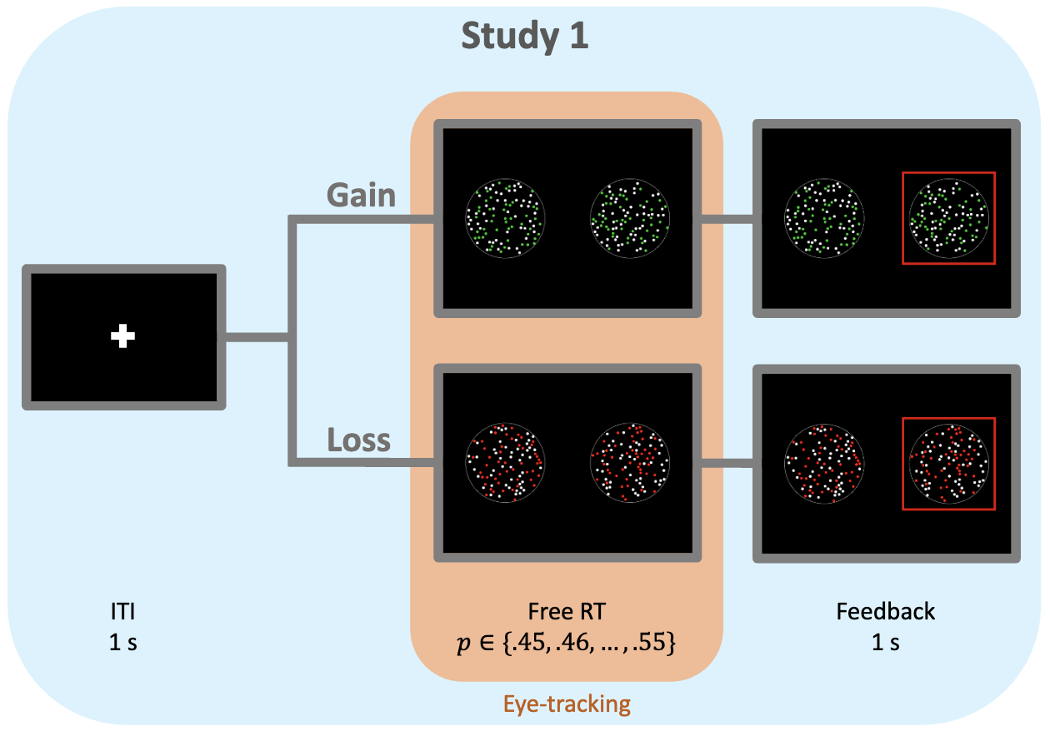

Slide 34
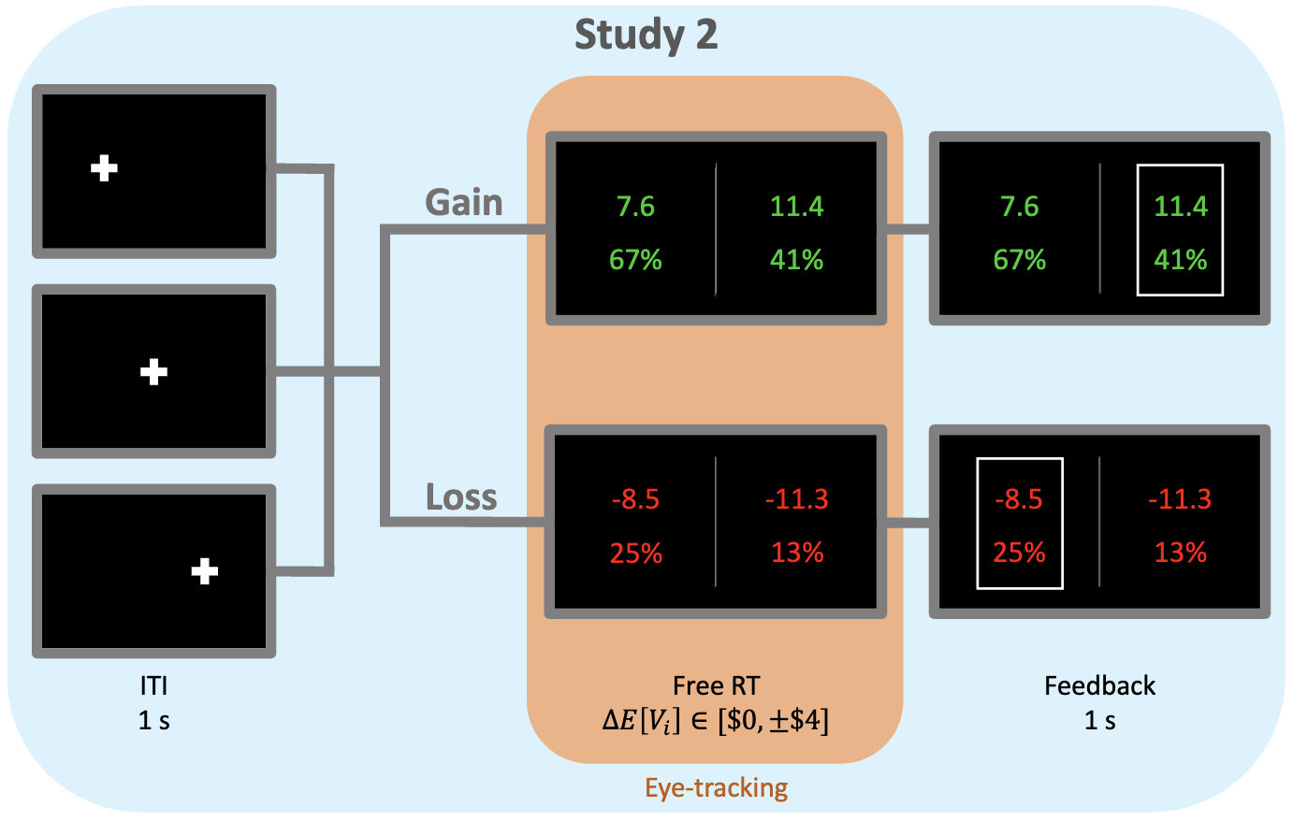

Slide 35
Basic Psychometrics

Slide 36
Basic Psychometrics

Slide 37
Fixation Process

Slide 38
Predicted Attentional Choice Bias Reversals
Net Fixation Bias
Last Fixation Bias
Pr(Left Chosen)
Pr(Choose Last Fix.)
Final Time Advantage Left
Left Rating - Right Rating

Slide 39
Attentional Choice Biases
Net Fixation Bias
Last Fixation Bias
Pr(Left Chosen)
Pr(Choose Last Fix.)
Final Time Advantage Left
Left Rating - Right Rating

Slide 40
Attentional Choice Biases
Net Fixation Bias
Last Fixation Bias
Pr(Left Chosen)
Pr(Choose Last Fix.)
Final Time Advantage Left
Left Rating - Right Rating

Slide 41
Models: Simulations

Slide 42
aDDM: Simulated Attentional Choice Biases

Slide 43
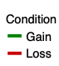

aDDM with $θ∈(1,2)$ in Losses: Simulated Attentional Choice Biases

Slide 44
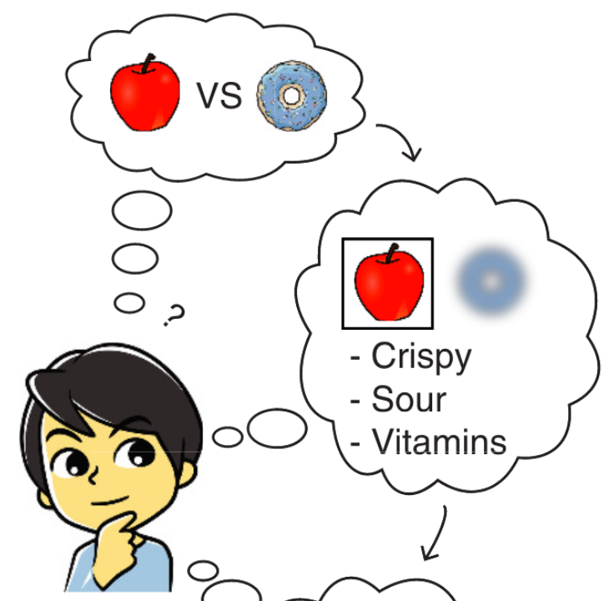
Intuition for $θ∈(0,1)$
V( ) = V( )
See Jang, Sharma, Drugowitsch (2021, eLife); Callaway, Rangel, Griffiths (2021, PLoS Comput Bio)

Slide 45
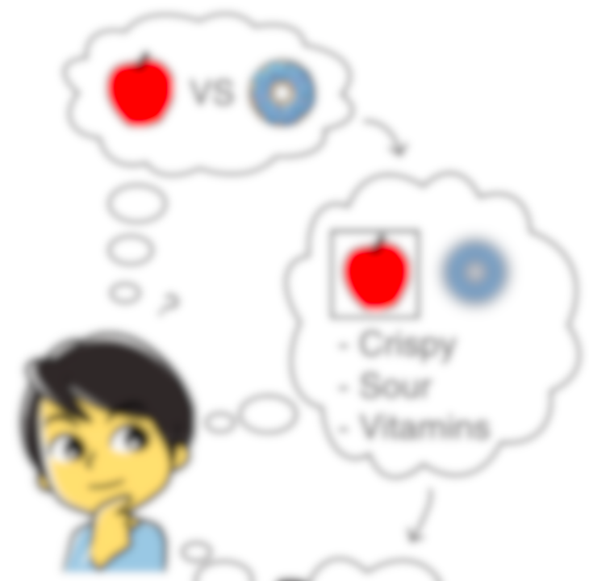

Intuition for $θ∈(0,1)$
V( ) sample
Evidence
V( ) = V( )
Time
V( ) sample
See Jang, Sharma, Drugowitsch (2021, eLife); Callaway, Rangel, Griffiths (2021, PLoS Comput Bio)

Slide 46
(mis)Intuition for $θ>1$
V( ) sample
V( ) sample
See Jang, Sharma, Drugowitsch (2021, eLife); Callaway, Rangel, Griffiths (2021, PLoS Comput Bio)

Slide 47
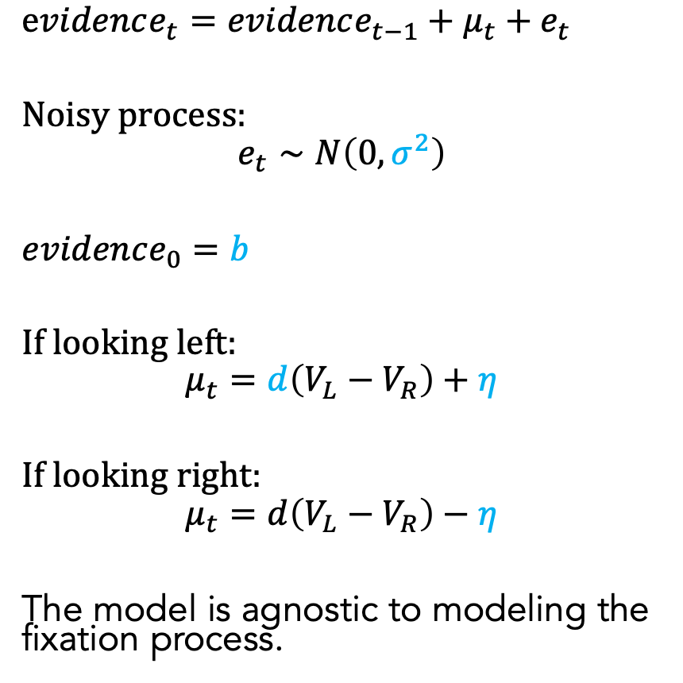
Additive Attentional Drift-Diffusion-Model (AddDDM)
$evidence_{t}=evidence_{t−1}+μ_{t}+e_{t}$
Noisy process:
$$e_{t}∼N\left(0, σ^{2}\right)$$
$evidence_{0}=b$
If looking left:
$$μ_{t}=d\left(V_{L}−V_{R}\right)+η$$
If looking right:
$$μ_{t}=d\left(V_{L}−V_{R}\right)−η$$
The model is agnostic to modeling the fixation process.
Notes:
noisy
bias
drift: ddm in value based decisions: evidence accumulated is value comparison
drift
sim
explain fixation sampling process

Slide 48
AddDDM: Simulated Attentional Choice Biases

Slide 49
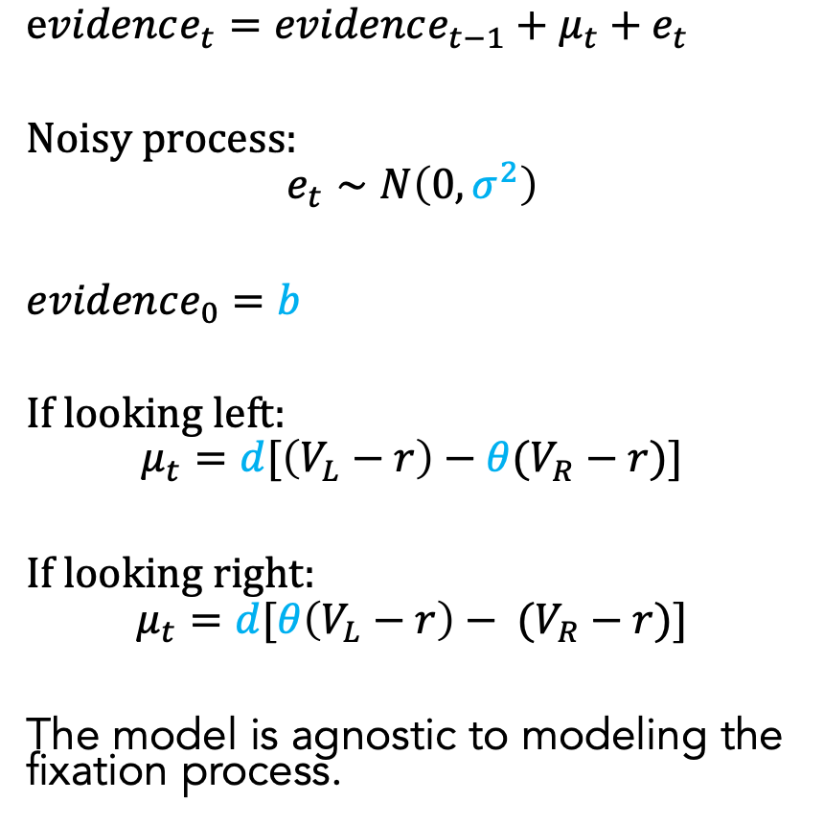
Referende-Dependent Attentional Drift-Diffusion-Model (RaDDM)
$evidence_{t}=evidence_{t−1}+μ_{t}+e_{t}$
Noisy process:
$$e_{t}∼N\left(0, σ^{2}\right)$$
$evidence_{0}=b$
If looking left:
$$μ_{t}=d[\left(V_{L}−r\right)−θ(V_{R}−r)]$$
If looking right:
$$μ_{t}=d[θ\left(V_{L}−r\right)− (V_{R}−r)]$$
The model is agnostic to modeling the fixation process.
Notes:
noisy
bias
drift: ddm in value based decisions: evidence accumulated is value comparison
drift
sim
explain fixation sampling process

Slide 50
RaDDM: Simulated Attentional Choice Biases

Slide 51
Parameter Recovery Exercises: Can we recover the data-generating model?

Slide 52
Models: Experiment Data

Slide 53
Model Comparison Using Posterior Model Probabilities

Slide 54
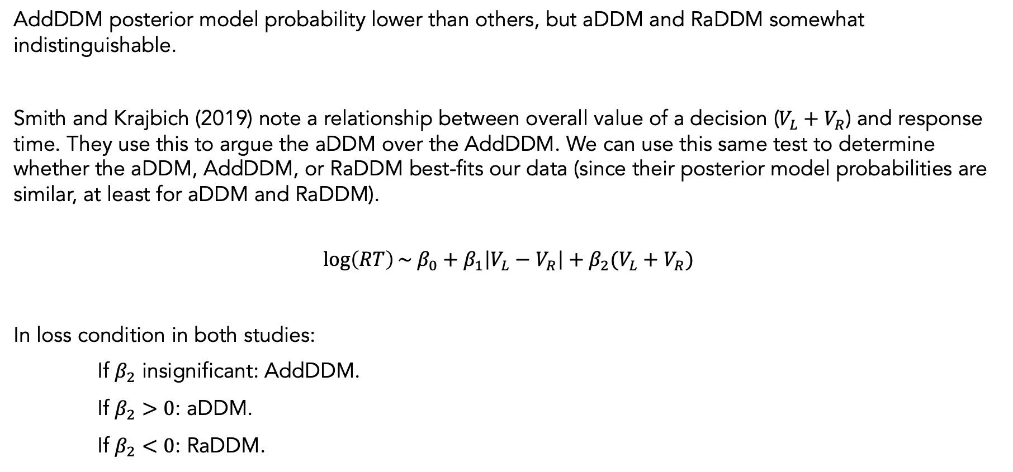
A Regression Test to Select Best Model
AddDDM posterior model probability lower than others, but aDDM and RaDDM somewhat indistinguishable.
Smith and Krajbich (2019) note a relationship between overall value of a decision ($V_{L}+V_{R}$) and response time. They use this to argue the aDDM over the AddDDM. We can use this same test to determine whether the aDDM, AddDDM, or RaDDM best-fits our data (since their posterior model probabilities are similar, at least for aDDM and RaDDM).
$$\log\left(RT\right)\sim β_{0}+β_{1}\left|V_{L}−V_{R}\right|+β_{2}(V_{L}+V_{R})$$
In loss condition in both studies:
If $β_{2}$ insignificant: AddDDM.
If $β_{2}>0$: aDDM.
If $β_{2}<0$: RaDDM.

Slide 55
Simulations of RT(OV) coming soon.

Slide 56
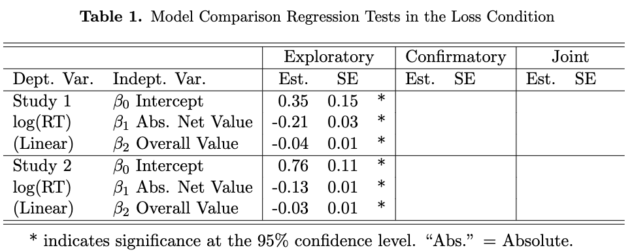
RaDDM Selected According to Our Regression Test
$$\log\left(RT\right)\sim β_{0}+β_{1}\left|V_{L}−V_{R}\right|+β_{2}(V_{L}+V_{R})$$

Slide 57
RaDDM Parameter Estimates from Both Studies

Slide 58
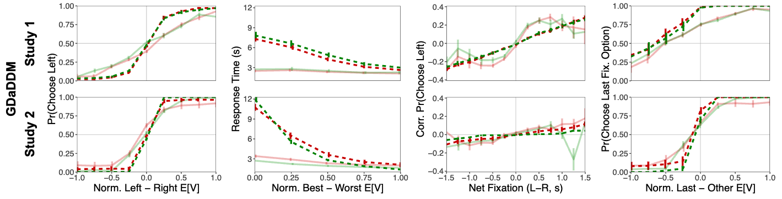
Out-of-Sample Predictions Compared with Observed Data (This is an older version with collapsing bounds, don’t have new version ready yet, but I still think it speaks to the accuracy of out-of-sample predictions. I took out collapsing bounds due to some issues with parameter recovery. Zeynep is having these issues with collapsing bounds too, we haven’t solved why yet.)
RaDDM

Slide 59
Fixation Cross Manipulations in Study 2

Slide 60
Doesn’t affect net fixation bias

Slide 61
Doesn’t affect last fixation bias

Slide 62
Does affect first fixation bias (note that I’m using a different definition of first fixation bias than in Peripheral paper. No effect on FirstFixationDuration(netValueOfFirstFixOption).)

Slide 63
Extra stuff

Slide 64
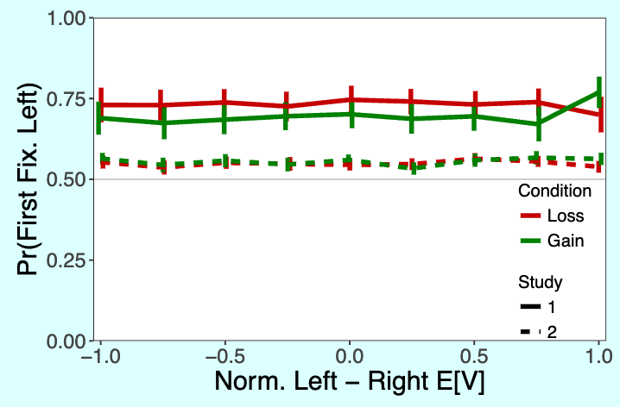

Slide 65
aDDM RDV examples in gain/loss figure from paper

